Slide 1
Census 2021
Work Assignments, Mobile Application and Dashboard
Presenter: Shonisani Maranda
Senior GIS Officer
Statistics South Africa
Date: 09 October 2020

Slide 2
Presentation outline
Work Assignments
  Objectives
  Web Application demo
Mobile Application
Dashboard
  Live Demo

Slide 3
Work assignments
Objectives
To manage field workflow
Subdivide equal amount of work across available field workers per census or survey
To assign and reassign Supervisor or fieldworkers when they are sick or when they resign
For Sweeping method during Census night.

Slide 4
Work assignments
Work assignment are done through web applications
Users are given usernames and password to access each application listed below
Pre - Work Allocation - Manager | pre_wa_manager | The data has passed the Preparation stage.ie. The QA is an on going process | This user is responsible to assign work to the FOO (pre_wa_foo user).
Pre - Work Allocation - Field Operations Officer | pre_wa_foo | The data has passed the Preparation stage.ie. The QA is an on going process | This user is responsible to assign work to the Supervisor (pre_wa_supervisor).
Pre - Work Allocation - Supervisor | pre_wa_supervisor | The data has passed the Preparation stage.ie. The QA is an on going process | This user is responsible to assign work to the Field Worker.
Pre - Work Allocation - Supervisor | pre_wa_supervisor | The data has passed the Preparation stage.ie. The QA is an on going process | This user is responsible to assign work to multiple field workers to the same geopoint. (e.g Census night, assigning multipe field workers to an SDI)

Slide 5
Mobile application
Survey 123 application
Navigation
Field data collection
Submit the survey.

Slide 6
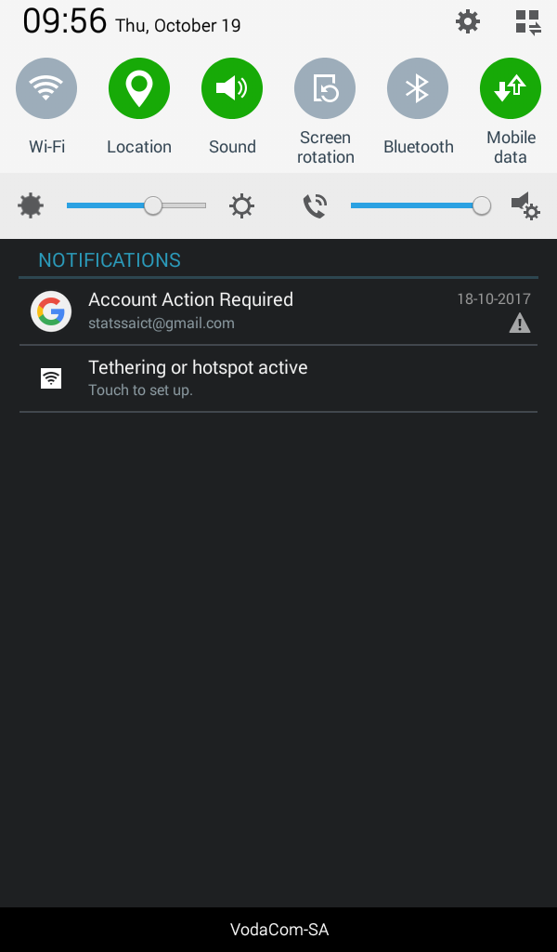
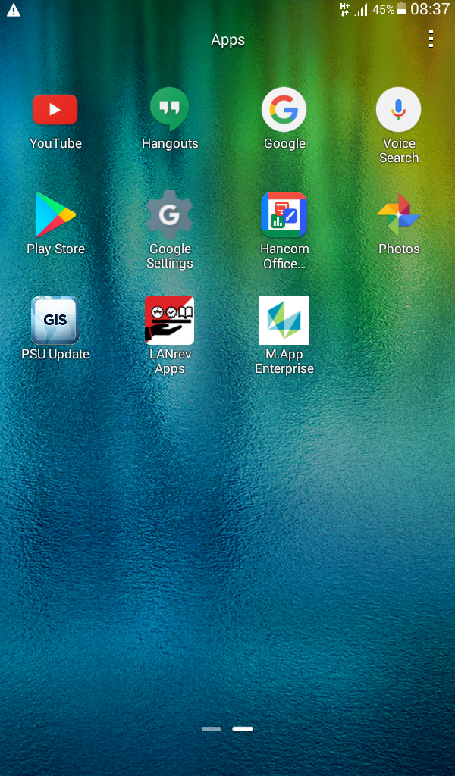

Device Pre - Checks
Swipe Down on the screen
Make sure location and mobile data is on (green)

Slide 7
Open Survey 123

Slide 8
Concepts and definitions
Survey123 for ArcGIS is an application that will be used to package GIF for field workers to be able to get to the enumeration areas (EA) and enumerate.
Explorer for ArcGIS is an application that delivers access to the digital maps.
ArcGIS Navigator is a Mobile Navigation Application that provides turn-by-turn, voice-guided directions on mobile devices.

Slide 9
Concepts and definitions
Location Tracker is a mobile application that enables the tracking of a user and saving the details for a route that a user has followed with the mobile device. The user can start and stop the tracking from within Survey123.
Trek2There is an application that gets you to any off-road location, where no trails or paths exist.

Slide 10
Concepts and definitions
Unpack Status is a process of indicating the progress made on the recording of Dwelling Units (DU) and other structures found at the geo point.
GIF Status is a process of indicating the progress made on geo point from Untouched to In-Progress or Completed.
Contact Status – Nature of contact between the Fieldworker and Respondent: Refusal, Access Pending and Access Granted.

Slide 11

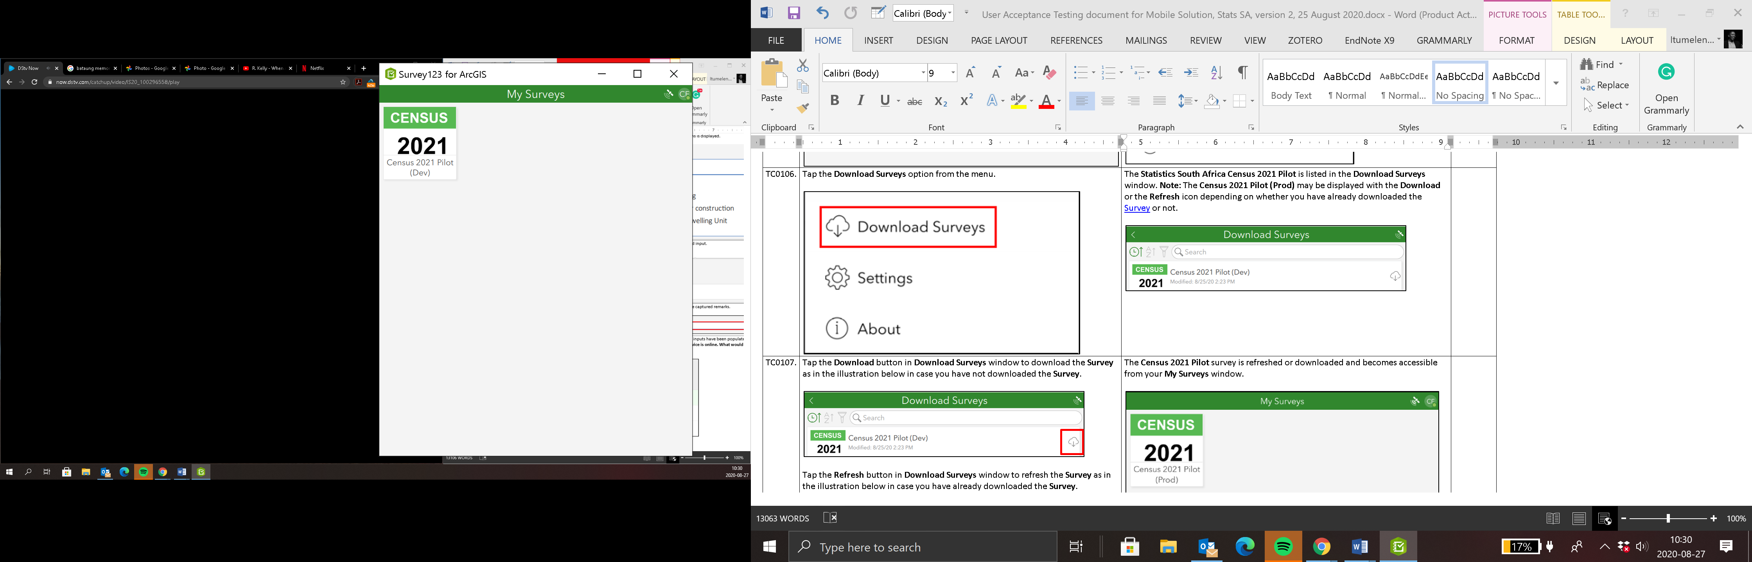
Initializing…. Screen
The Survey 123 for ArcGIS Mobile Solution initializes.
The My Surveys window is displayed with the Census 2021
Tap the More options at the top right section of the My Surveys window.

Slide 12
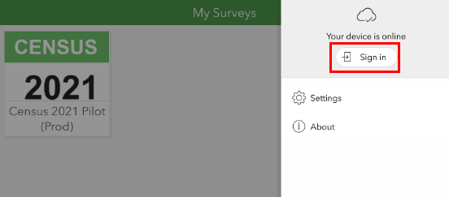
Sign in
Then, “your device is online” pane is displayed
Tap the Sign in, button from the My Surveys window.

Slide 13
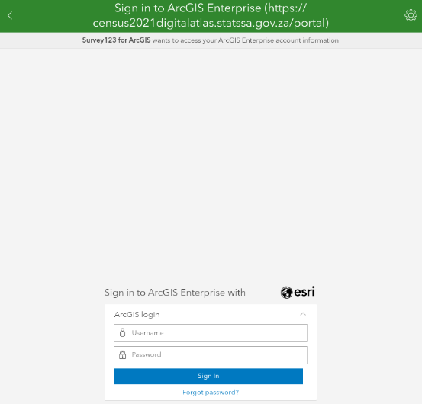
Sign in screen
The Sign in, to ArcGIS Enterprise (https://census2021digitalatlas.statssa.gov.za/portal)
Capture a valid
Username:
CPTFW11006
Password: StatisticsSouthAfrica1!
click the Sign In

Slide 14
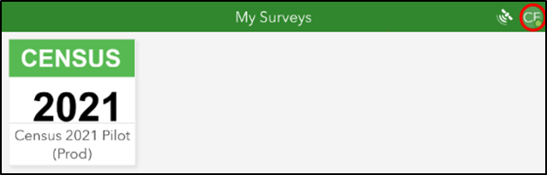
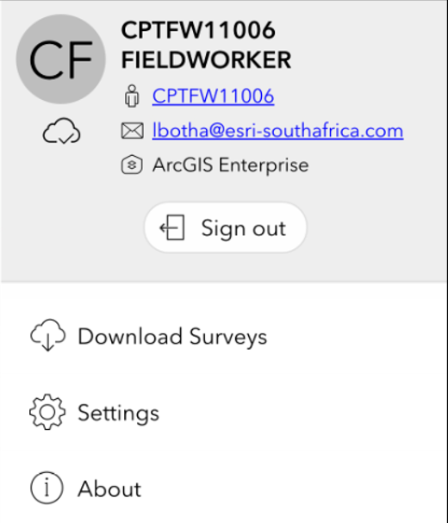
Sign in
Tap the user that you have signed in with e.g. (CF) at the top right corner of the window as in the illustration below.
The menu is displayed for the logged in user.

Slide 15
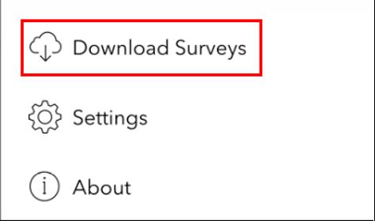
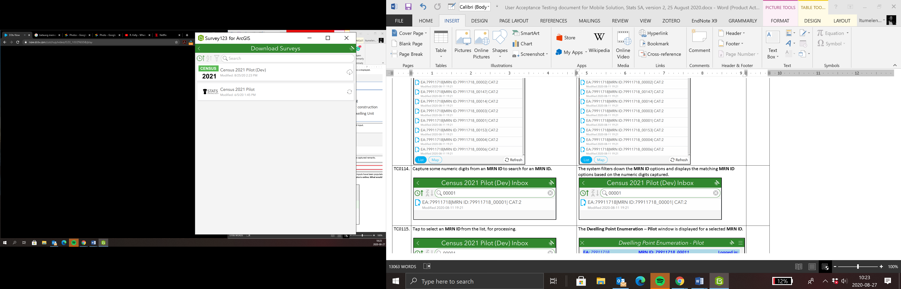
Download Surveys
Tap the Download Surveys option from the menu.
The Statistics South Africa Census 2021 Pilot is listed in the Download Surveys window. Note: The Census 2021 Pilot (Dev) may be displayed with the Download or the Refresh icon depending on whether you have already downloaded the Survey or not.

Slide 16
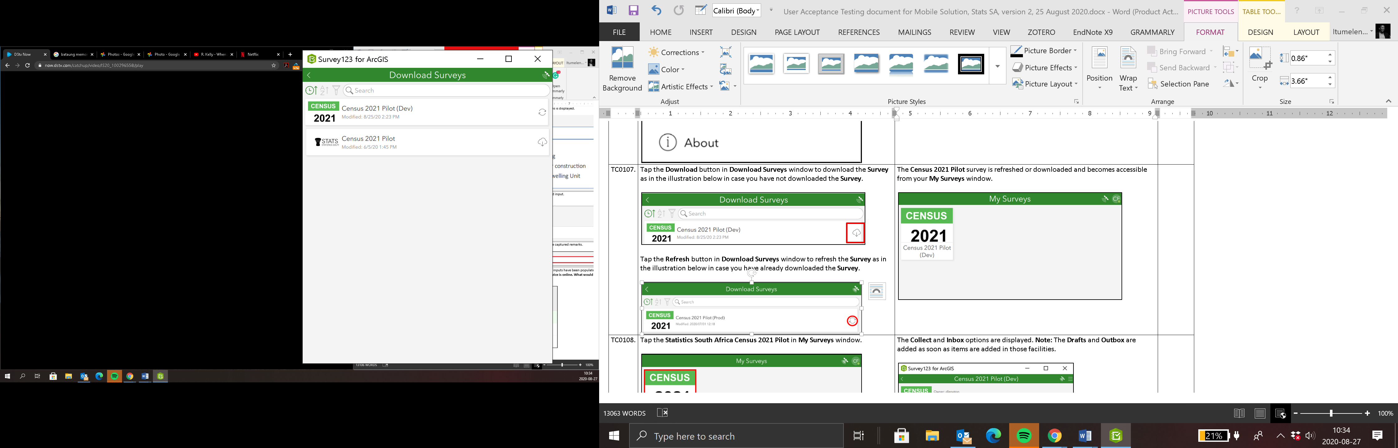
Download Surveys
Tap the Download button in Download Surveys window to download the Survey as in the illustration below in case you have not downloaded the Survey.
Tap the Refresh button in Download Surveys window to refresh the Survey as in the illustration below in case you have already downloaded the Survey.

Slide 17
Select Survey
The Census 2021 Pilot survey is refreshed or downloaded and becomes accessible from your My Surveys window.
Tap the Statistics South Africa Census 2021 Pilot in My Surveys window.

Slide 18
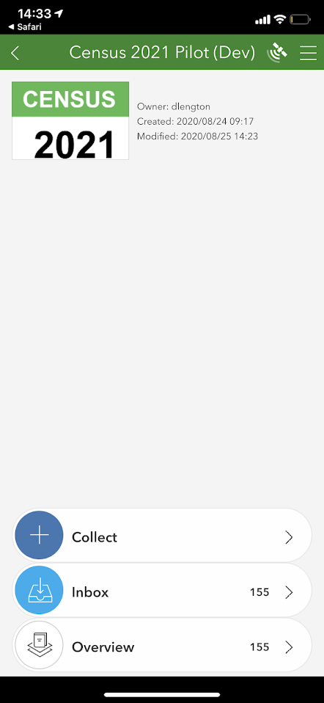
Select Survey
The Collect, Inbox and Overview options are displayed. Note: The Drafts and Outbox are added as soon as items are added in those facilities.

Slide 19
Select Survey Type
Tap the Inbox option in Census 2021 Pilot window.

Slide 20
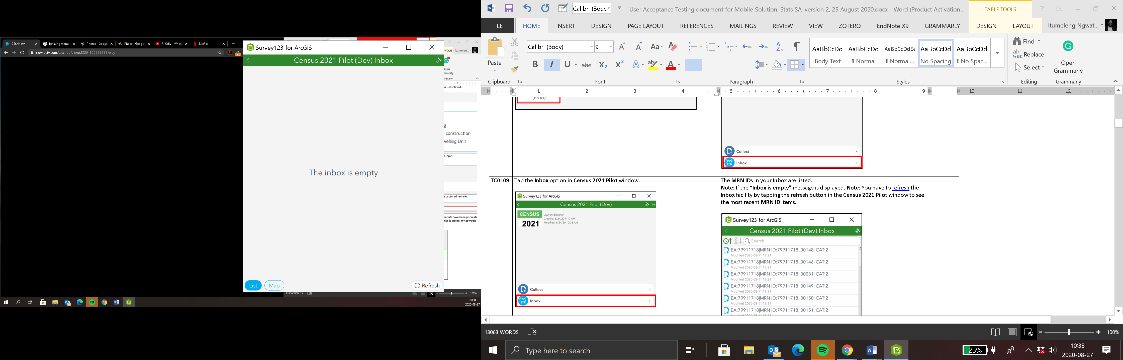
Select Survey Type
The MRN IDs in your Inbox are listed.
Note: If the “Inbox is empty” message is displayed. You have to refresh the Inbox facility by tapping the refresh button in the Census 2021 Pilot window to see the most recent MRN ID items.

Slide 21
Select Survey Type
Tap the Inbox option in Census 2021 Pilot window to open Inbox.

Slide 22
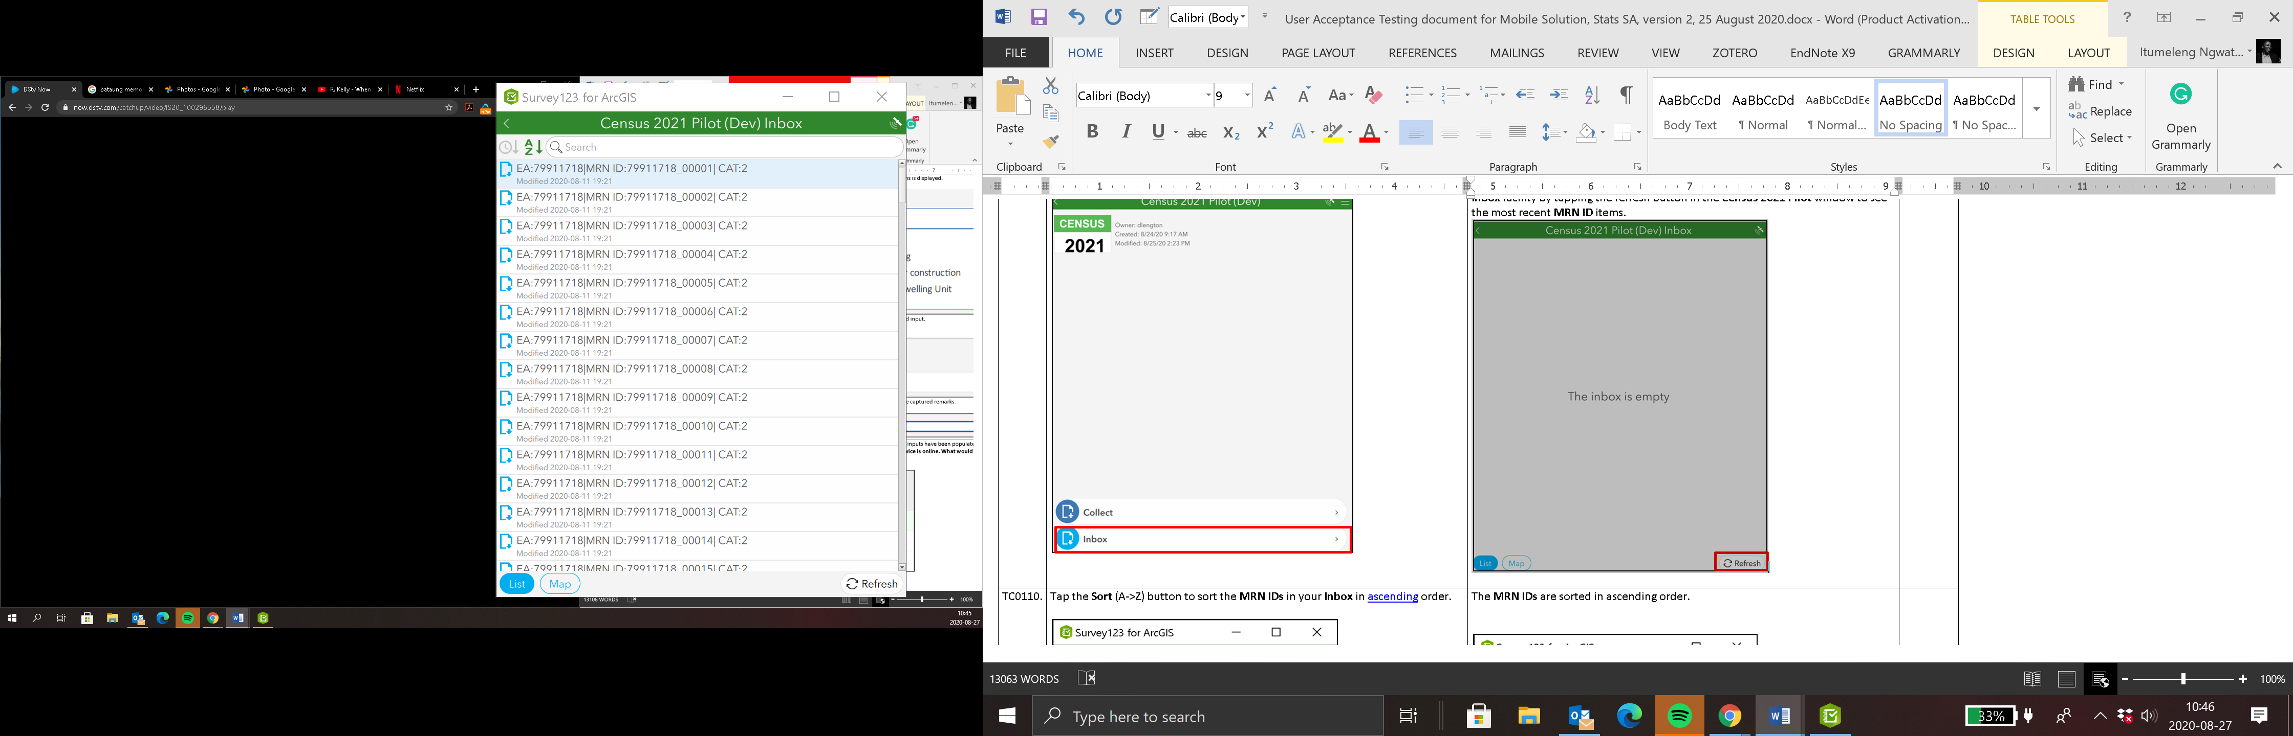
Inbox
Tap the Sort (A->Z) button to sort the MRN IDs in your Inbox in ascending and descending order.
Additional sorting options :
Newest
Oldest
Nearest
Farthest

Slide 23
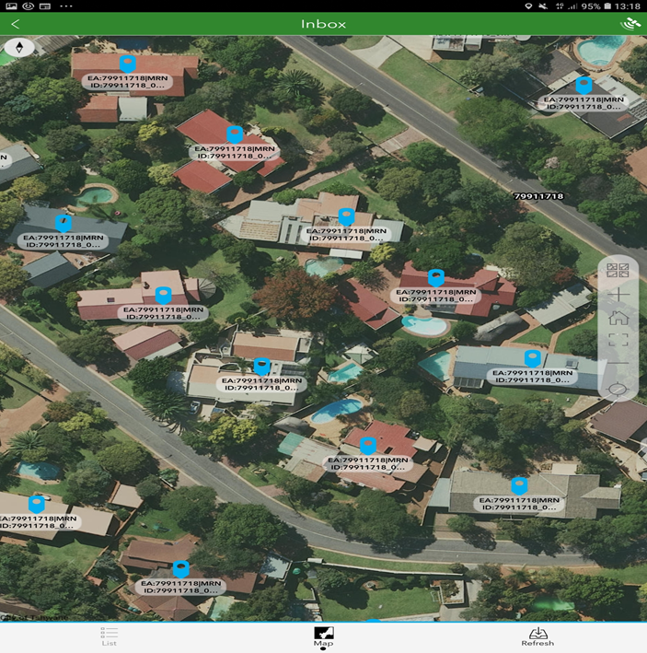
Inbox
Inbox has two view options:
  List
  Map
Tap on map to view MRN IDs spatially.
Tap refresh icon to refresh geo-points.
Tap list icon to go back to list view.

Slide 24
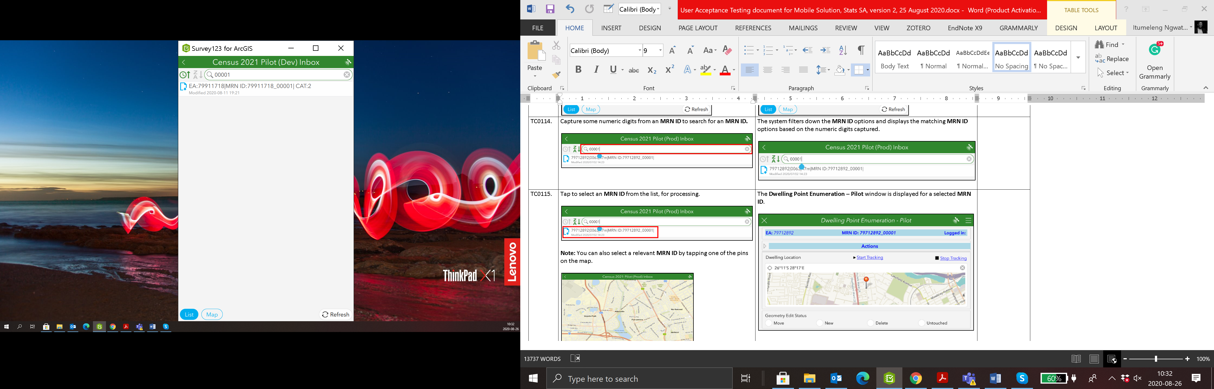
Selecting MRN
To select a MRN:
Tap on MRN from Inbox list OR
Tap on a Geo-point from map view OR
Search for the MRN ID.
Capture some numeric digits from a MRN ID to search for an MRN ID.
Tap to select a MRN ID from the list, for processing.

Slide 25
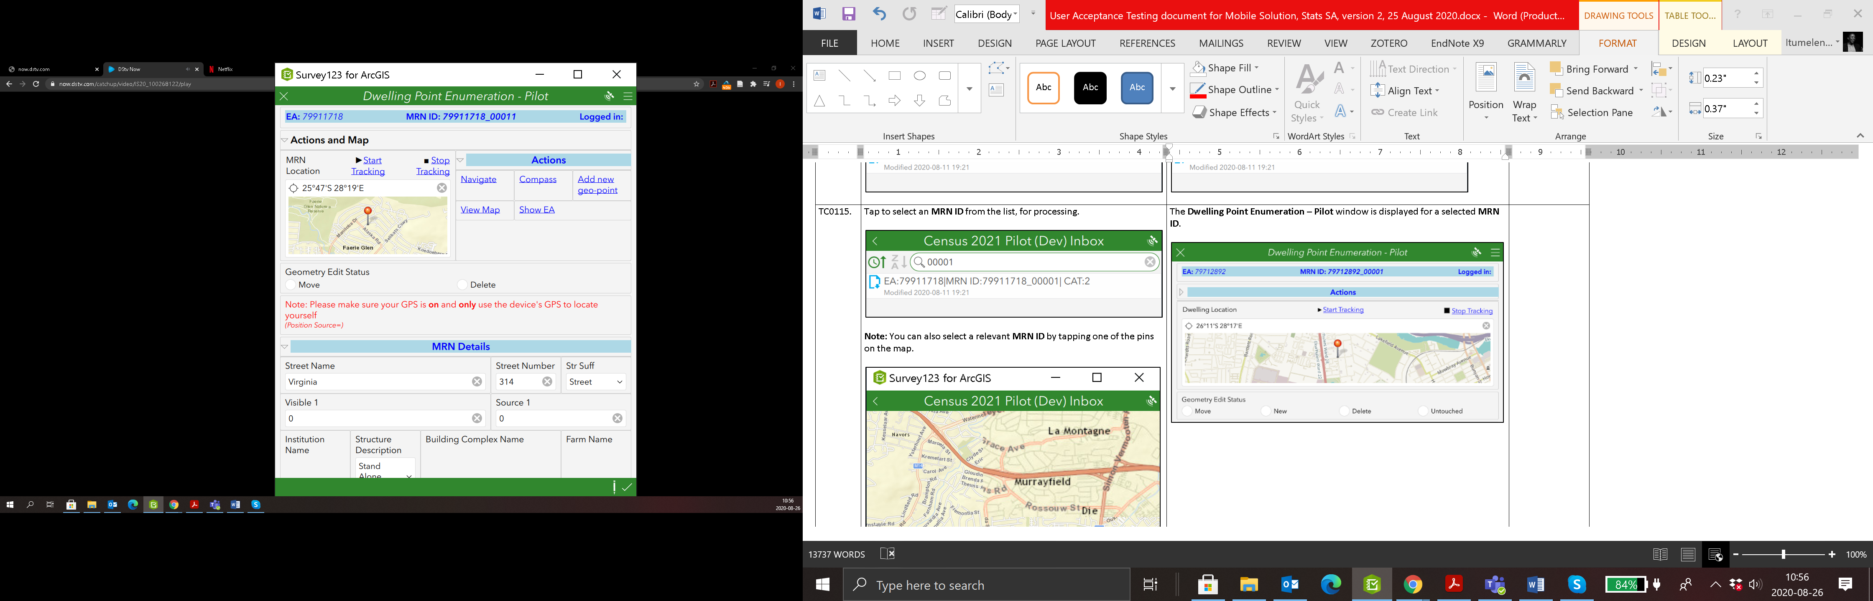
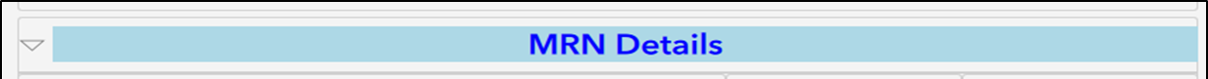
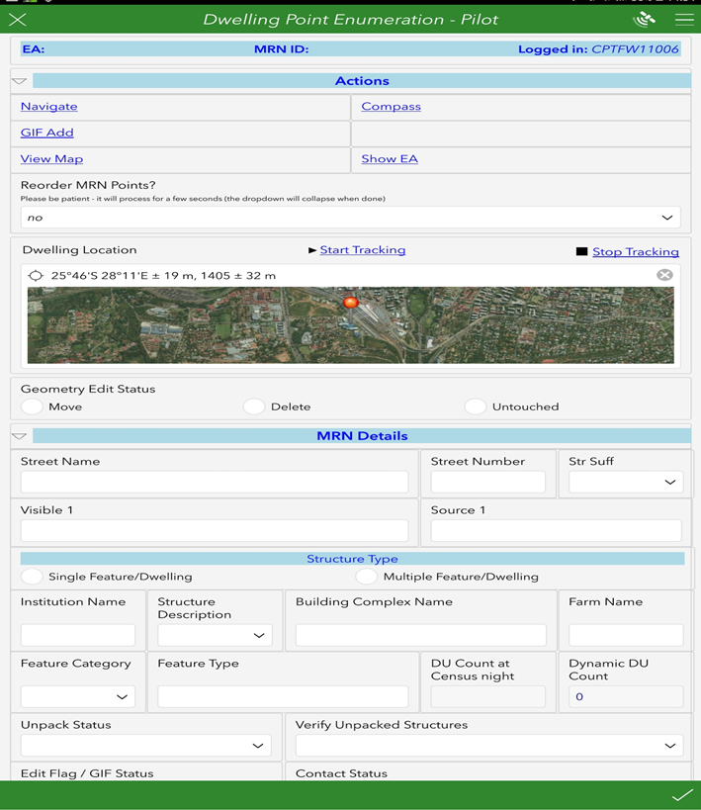
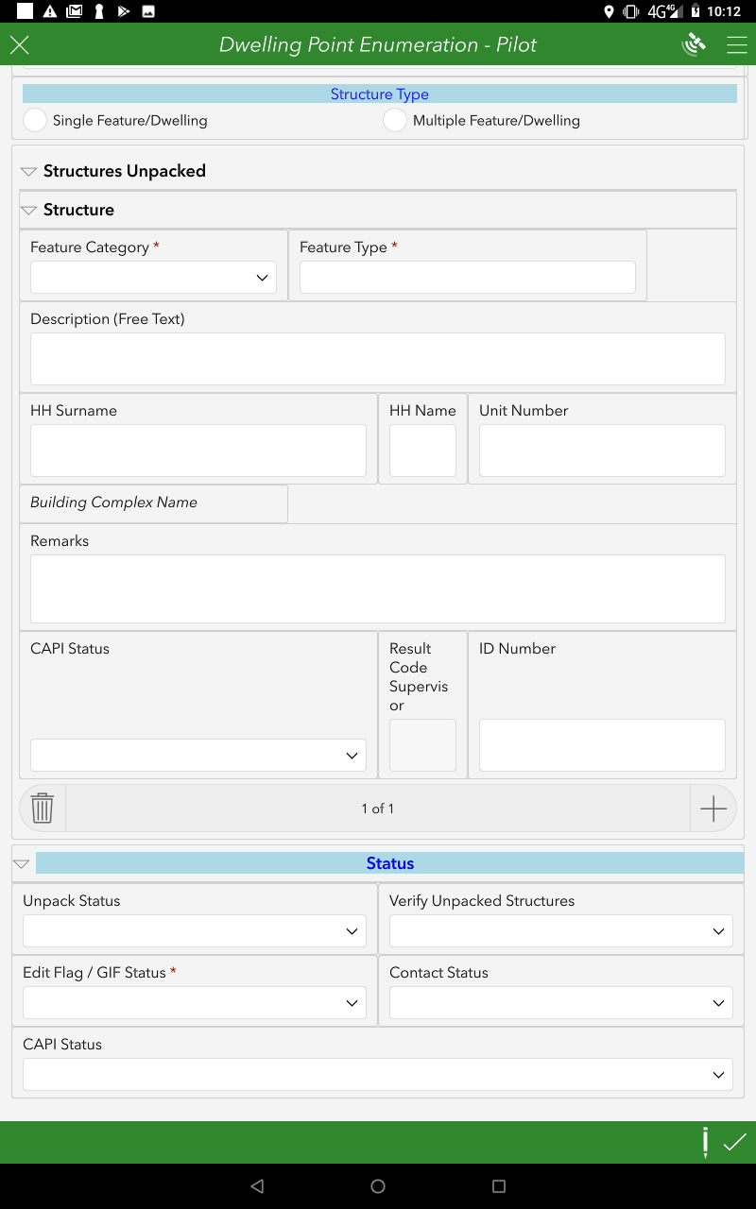
Dwelling Point Enumeration
The Dwelling Point Enumeration – Pilot window is displayed for a selected MRN ID.

Slide 26
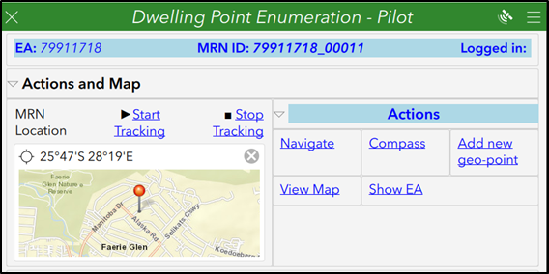
Actions and Map
Tap the Actions chevron as in the illustration below if the Actions menu is not expanded.
Tap the View Map option from the list of Actions.

Slide 27
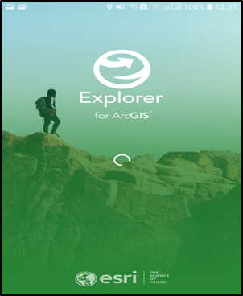
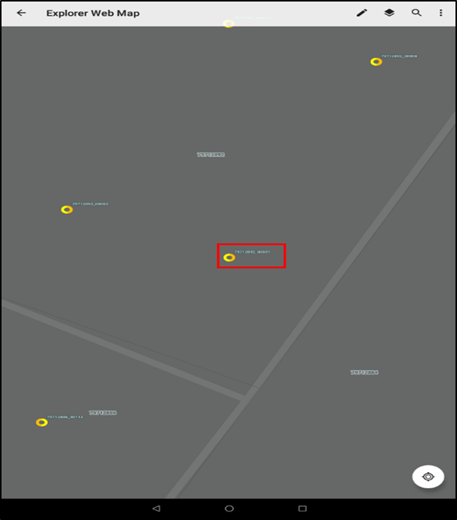
Actions and Map: view map
The Explorer for ArcGIS initializes
A currently selected MRN is displayed on the map.
Tap ← icon to go back

Slide 28
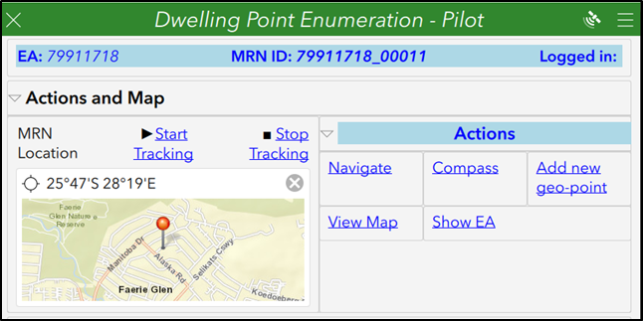
Actions and Map
The Actions menu is displayed with the option to “Show Enumeration Area (EA)”.
Tap Show EA launch Explorer for ArcGIS application.

Slide 29
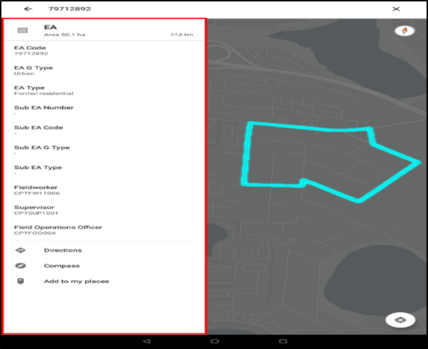
Actions and Map: show EA
The Explorer for ArcGIS initializes, and the EA to which the currently selected MRN belong is displayed on a map with the following EA Details:
  • EA Code,EA G Type,EA Type,Sub EA Number,Sub EA Code,Sub EA G Type,Sub EA Type
  • Fieldworker,Supervisor, and Field Operations Officer.
Tap ← icon to go back

Slide 30
Actions and Map
The action menu is displayed with the “Add new geo-point”
Tap Add new geo-point to open a blank MRN form.

Slide 31
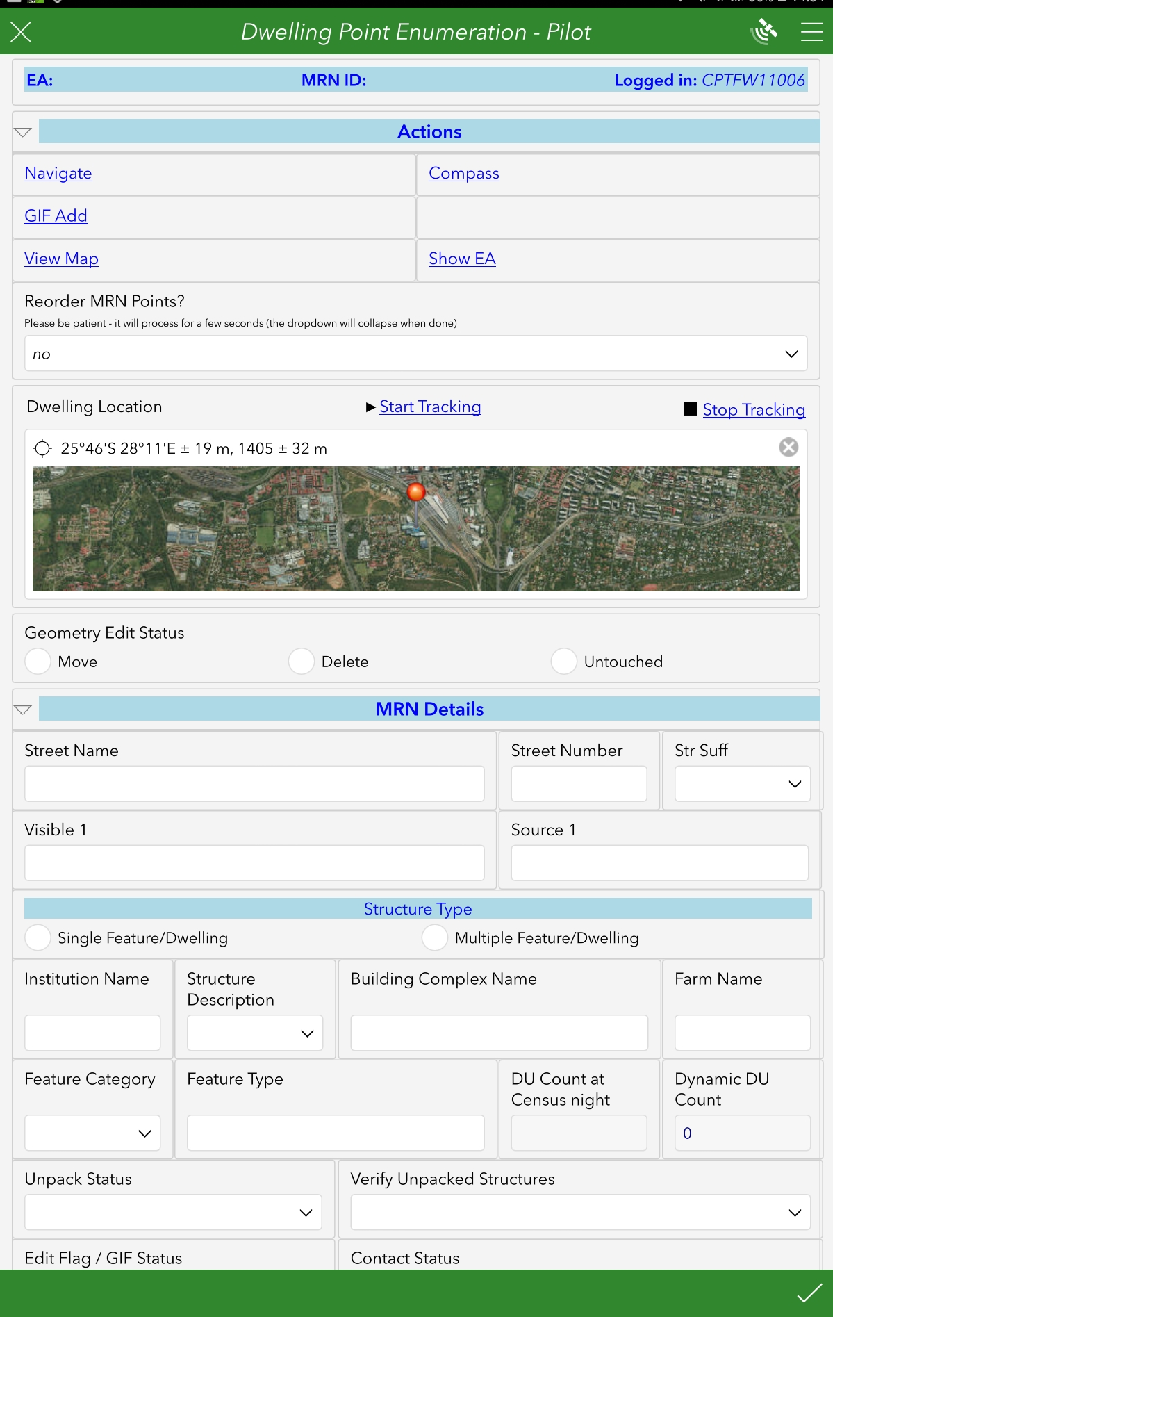
Adding new geo-point
Blank MRN form appears.
Tap on the map window to check if the pin is on the correct location if not then position it correctly.
Complete the MRN details.
Tap submit to send new geo-point.

Slide 32
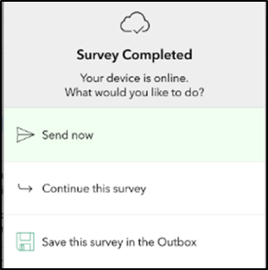

Adding new geo-point
The system validates if all mandatory input fields have been populated for the Surveys and “The Survey Completed, your device is online. What would you like to do?” dialog box is displayed.

Slide 33
Actions and Map
The Actions menu is displayed with the option to “Navigator”.
Tap Navigate to launch navigation application.

Slide 34
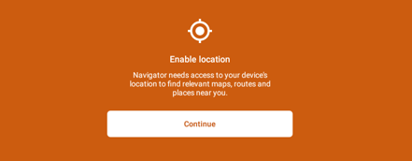
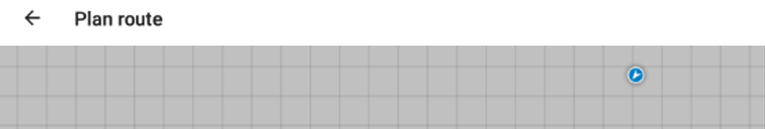
Navigation
The “Enable Location” prompt is displayed.
Tap continue
The Plan route window is displayed.

Slide 35
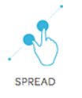

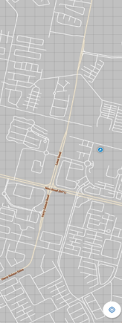
Navigation
Spread the touch screen surface to zoom in until you can see some road features on the map.
Once you can see the road features on the map, wait until a route is drawn on the map.

Slide 36
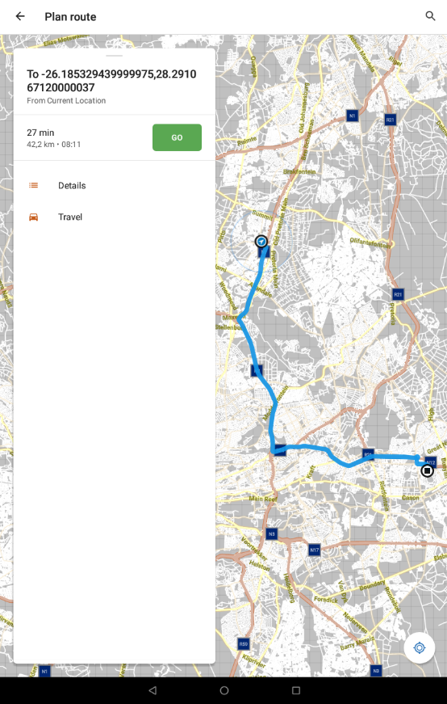
Navigation
The map is zoomed in displaying the map.
A Plan route window with a dialog box displaying the To 26.185329439999975, 28.291067120000037 (coordinates) is displayed.
The time it will take to get to the destination is displayed.
The Details and Travel also displayed on the dialog box.
A route from your current location to the MRN point is displayed on the map.
Tap details

Slide 37
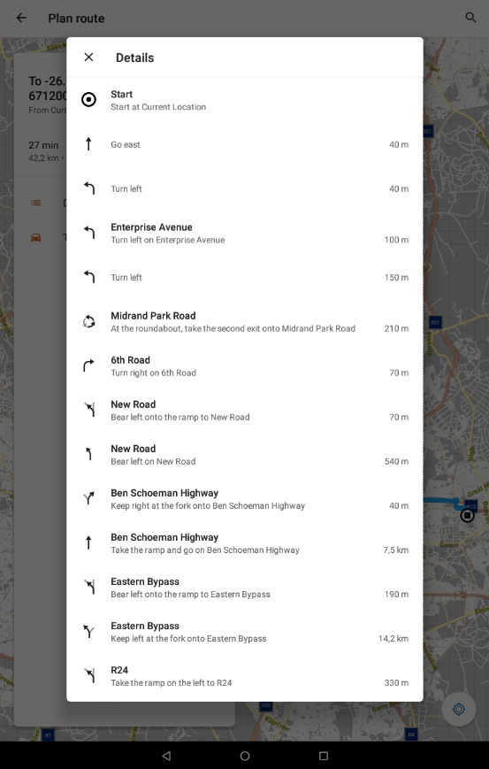
Navigation
The Details dialog box is displayed with the directions to the MRN point or destination.
Tap the x icon in the Details to close.

Slide 38
Navigation
The Details dialog box is dismissed.
Tap the GO button on the dialog box.

Slide 39
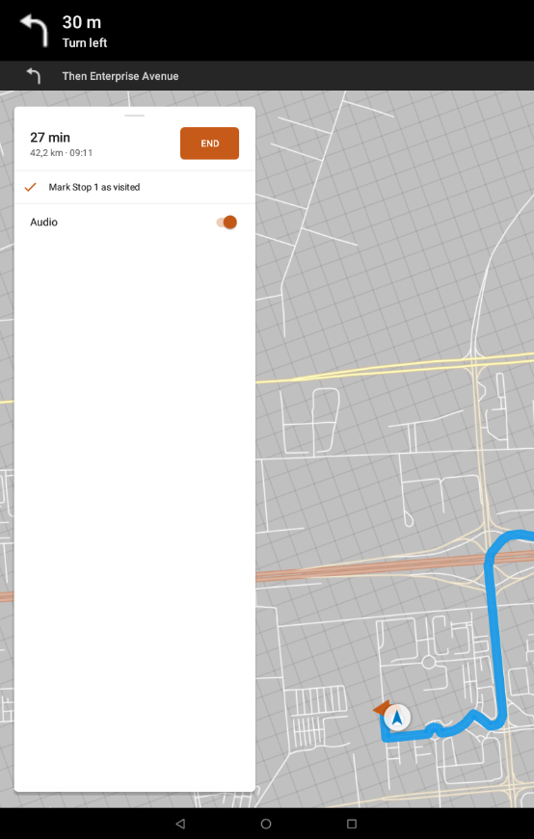
Navigation
The system navigates you to the selected destination with the turn by turn voice commands (If applicable).
Tap the End button to dismiss the navigation.

Slide 40
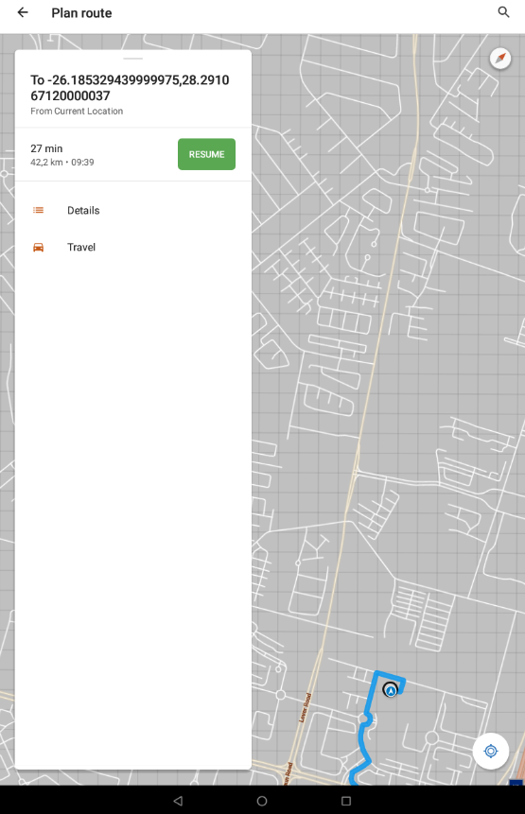
Navigation
The navigation is stopped with an option for Resume.
Tap ← icon to go back to Survey 123

Slide 41
Actions and Map
The Actions menu is displayed with the option “Compass”:
Tap Compass to launch Trek2There application.

Slide 42
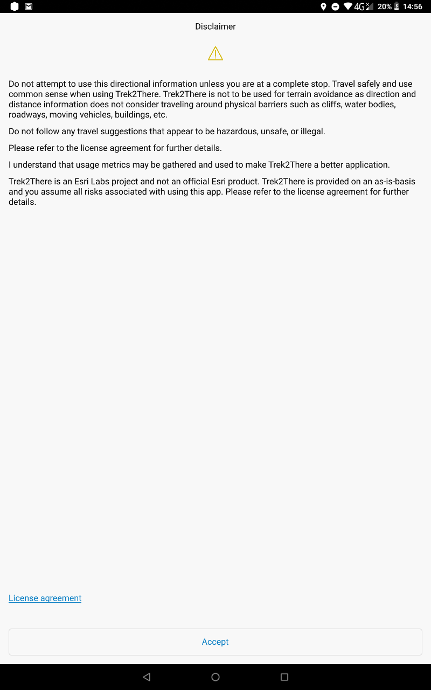

Compass
Trek2there for ArcGIS initializes.
The Disclaimer is displayed.
Tap accept.

Slide 43
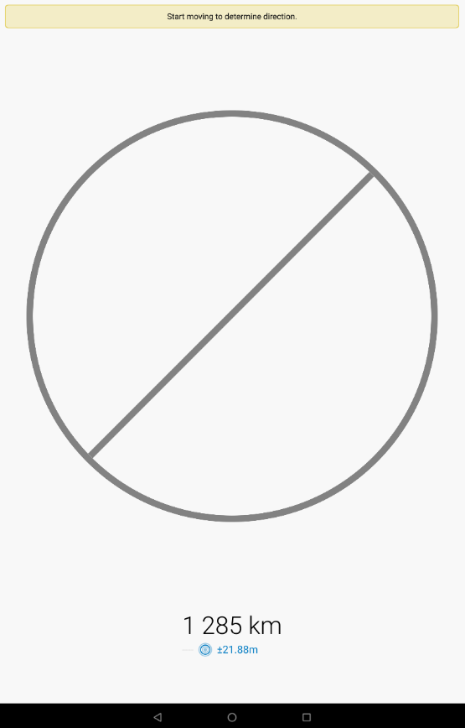
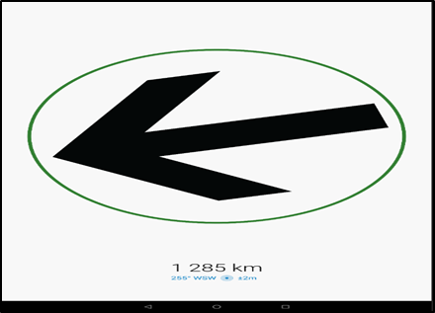
Compass
The “Start moving to determine direction” prompt is displayed.
The arrow rotates to show you the direction and distance to your destination.
Arrow will show direction correctly when you start moving.
Details will update automatically, guiding you on which direction to follow.

Slide 44
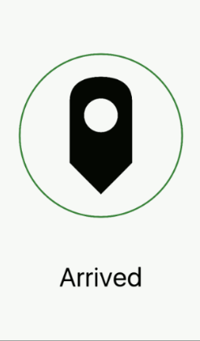
Compass
The “Arrived” notification is displayed.
Tap close to go back to survey 123.

Slide 45
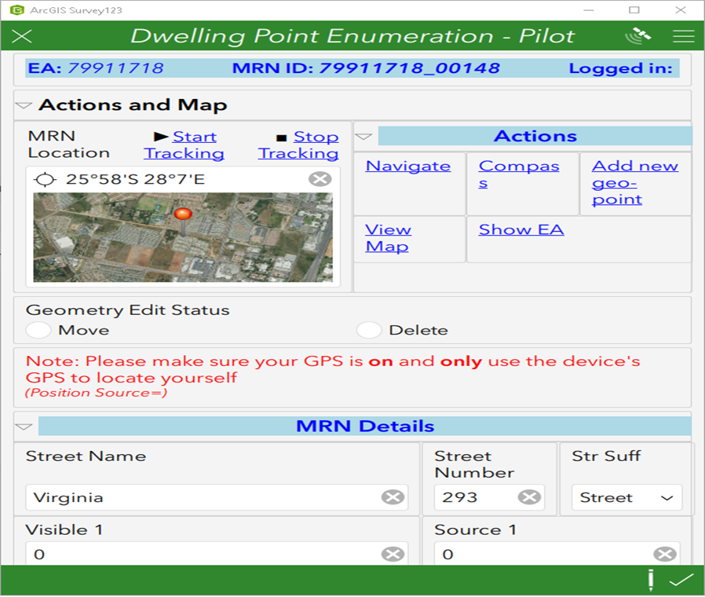
MRN Details
Geometry Edit Status
  Move
  Delete
Capture the MRN Details
  Street name
  Street number
  Str Suff
  Visible 1
  Source 1
Scroll down until you see “STRUCTURES UNPACKED”

Slide 46
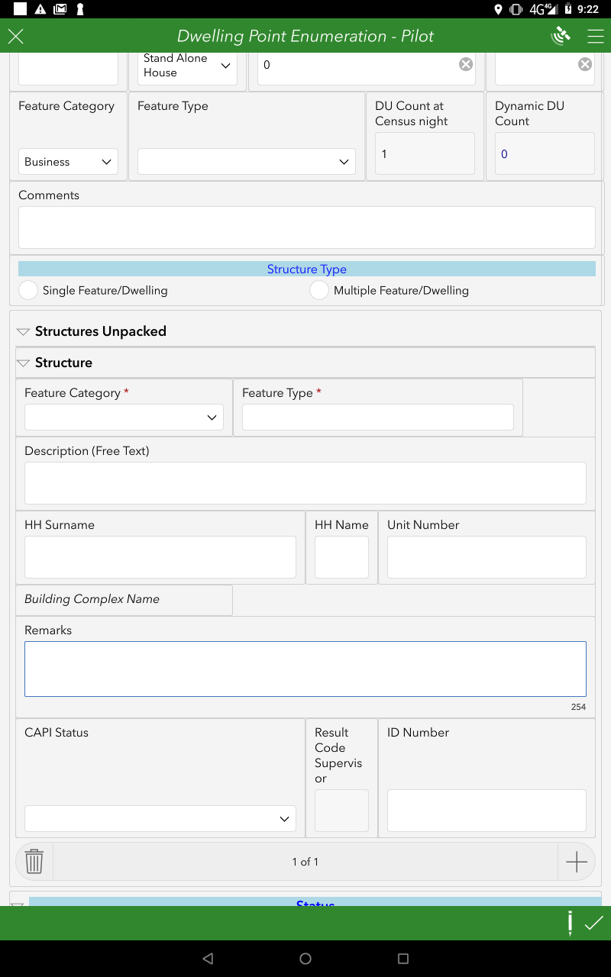
Structures Unpacked
The process of recording all structures found at the geo point e.g garage, shop, dwelling unit, crèche etc.
Structure Type – flagged to indicate whether there is need for unpacking or not
Multiple Feature/Dwelling Units
Single Feature/Dwelling

Slide 47
Structures Unpacked
Note:
The FW will begin probing the property and using field methodologies to unpack the features in a property and identify their use. They identify the DUs in the property as well as businesses, store rooms etc.
To start unpacking (adding structures) populate information about the structure.
To add another structure, the FW should press the “+” sign and populate information about structure.
Note: The Count for the Structures increases from 1 of 1 to 2 of 2 accordingly.
Scroll down to status

Slide 48
Status
Tap a dropdown arrow for Unpack Status input field.
Tap a dropdown arrow for Verify Unpacked Status input field. NB: This section can only be completed by Supervisors
Tap a dropdown arrow for Edit Flag/ GIF Status input field. NB: This is a Mandatory field.
Tap a dropdown arrow for Contact Status input field.

Slide 49
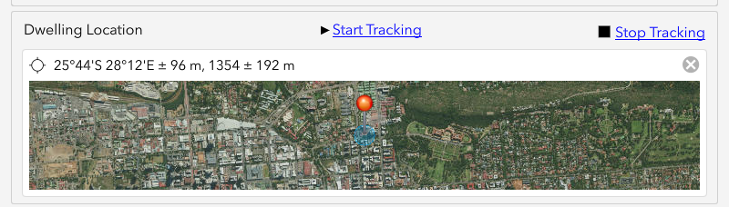
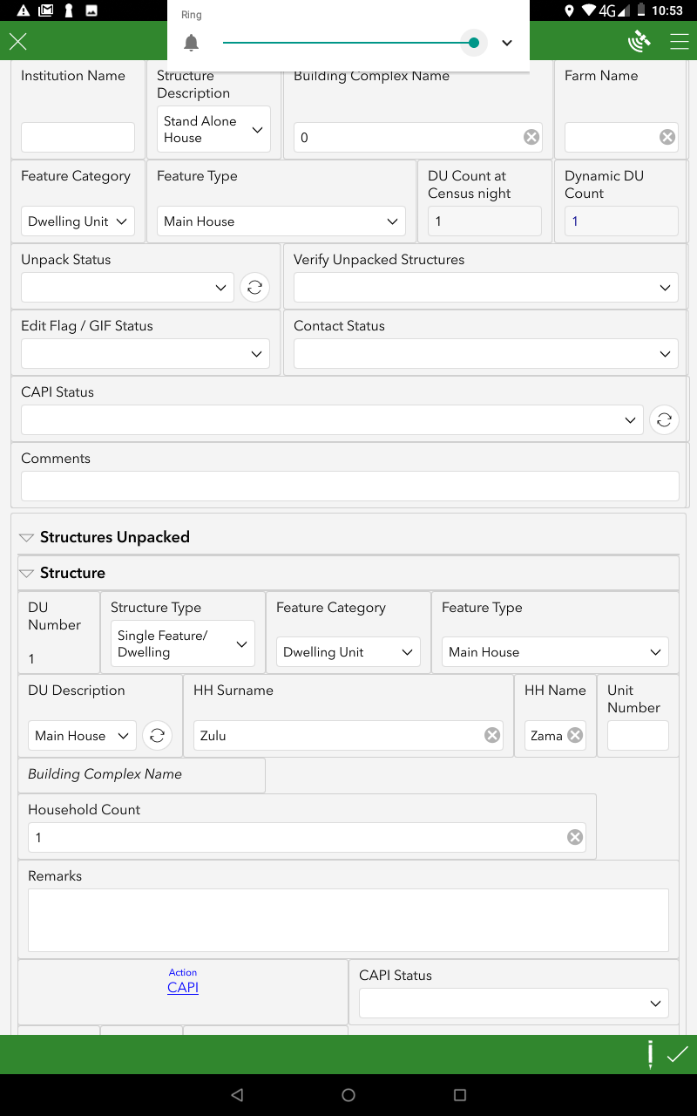
Action CAPI
Action CAPI: Distance
Tap the GPS location button on the map to locate yourself on the map.
The map is centred at your current location. If you are within a predefined distance from the MRN, CAPI can be launched.

Slide 50
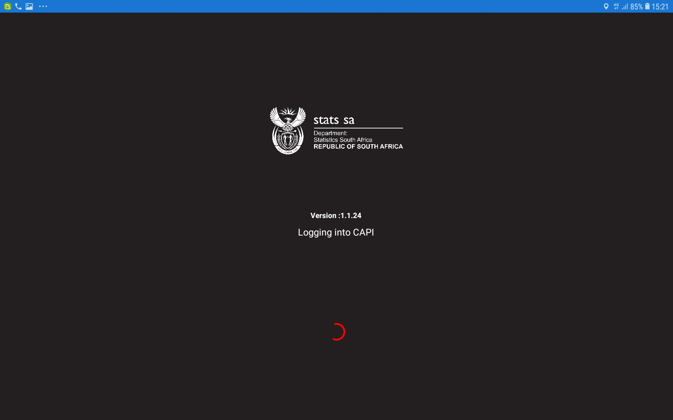
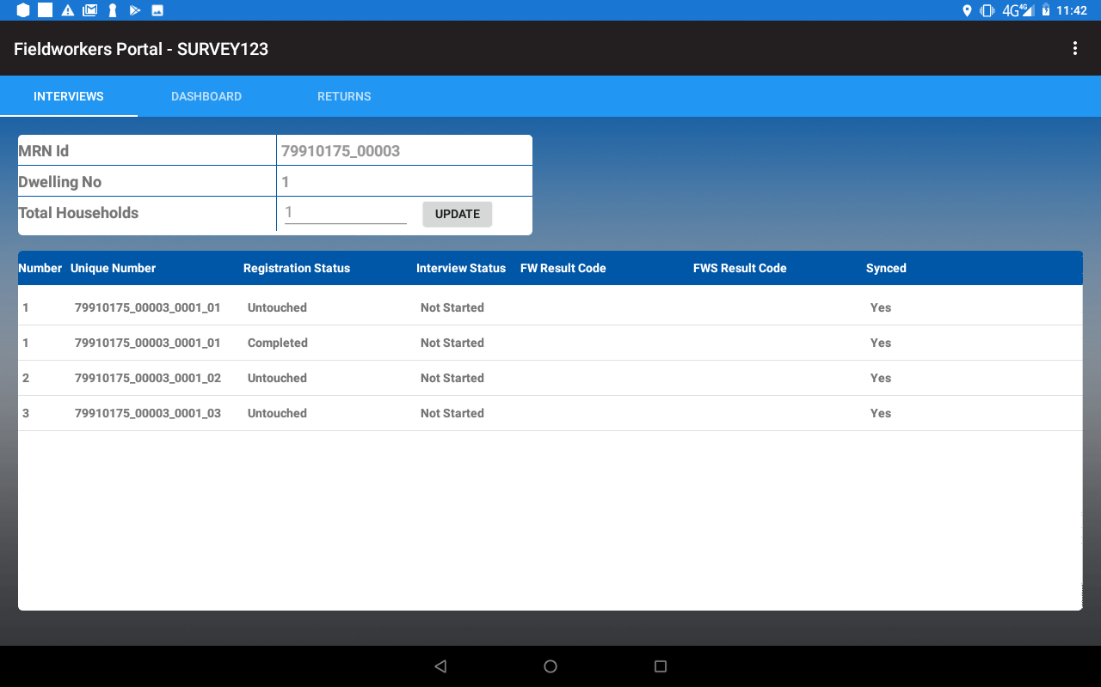
Action CAPI: Interviewer
The Interviewer application launches.
The Interviewer window is displayed.

Slide 51

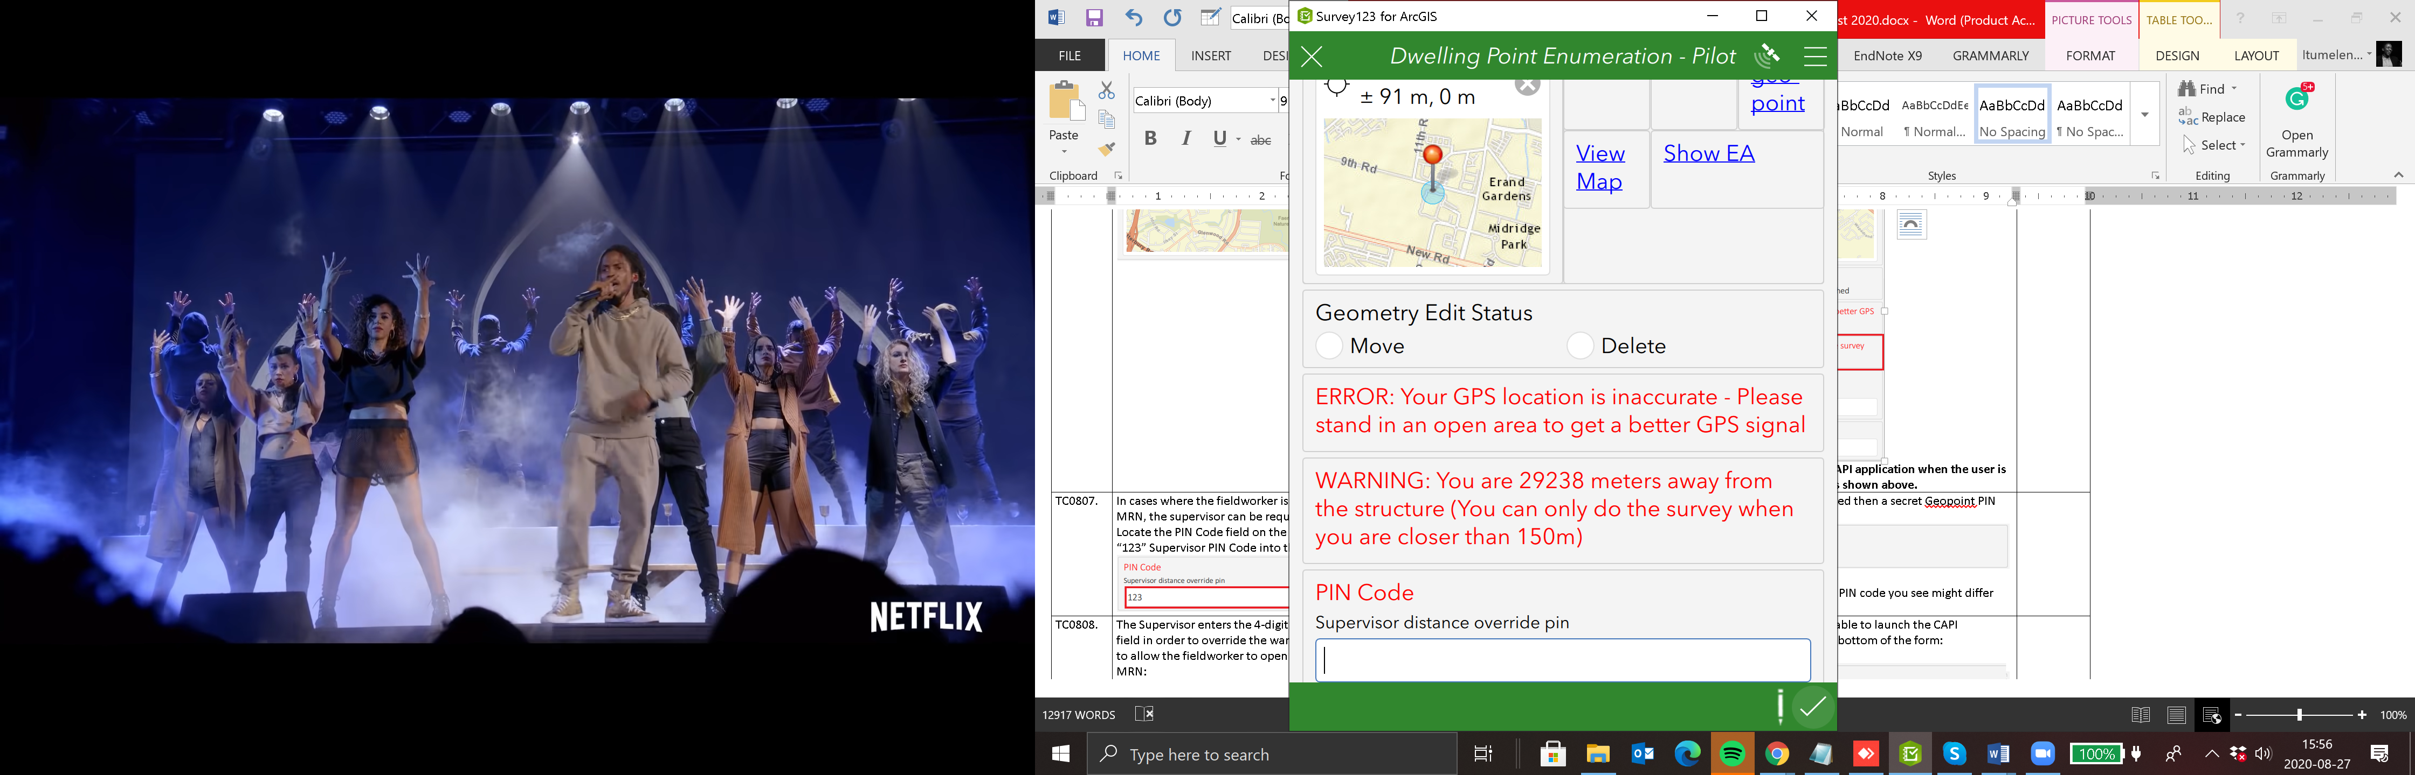
If you are not within a predefined distance from the MRN a warning will be shown as shown.
Note: Supervisor intervention is required to open the CAPI application when the user is not within the predefined buffer distance of an MRN.

Slide 52
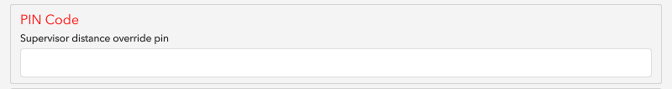
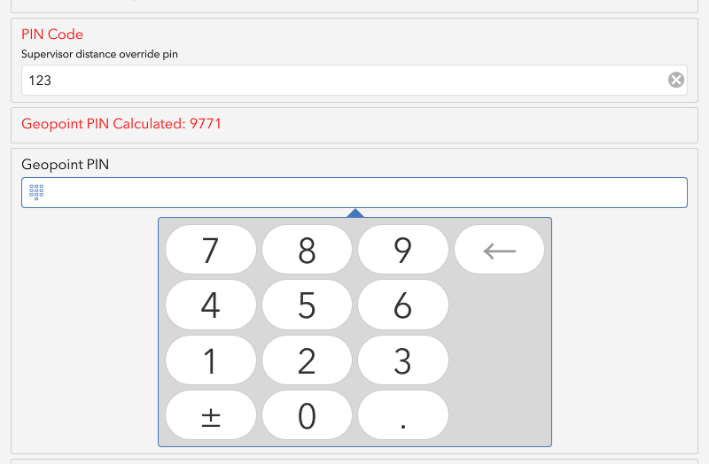
The supervisor can be requested to override the distance validation: Locate the PIN Code field on the survey.
123
The calculated PIN is unique to each MRN and the PIN code you see might differ from the example above.
9771

Slide 53
The action CAPI becomes available.
Tap the Action CAPI option to launch the CAPI application.

Slide 54
Action CAPI: Interviewer
The Interviewer application launches.
The Interviewer window is displayed.
Tap tree line to go back to survey 123

Slide 55
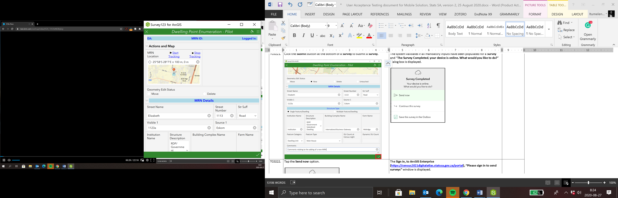
Submit survey
Click the tick (√) icon at the bottom of the form to submit.

Slide 56

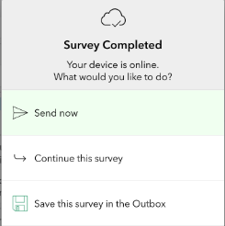
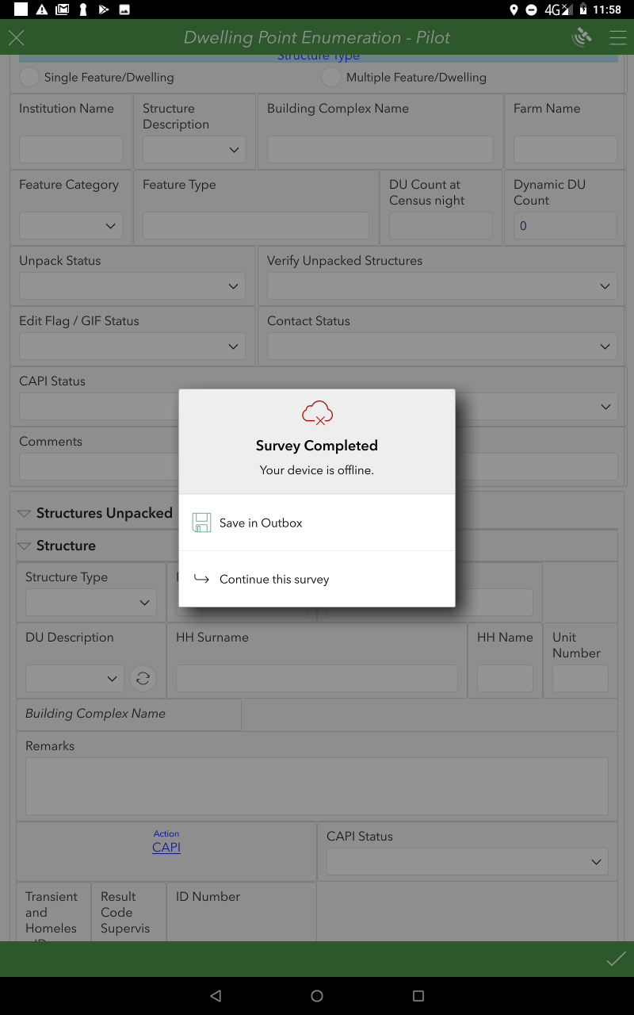
The system validates if all mandatory input fields have been populated for the Surveys
The Survey Completed, dialog box is displayed
Your device is online.
What would you like to do?
Your device is offline.
Tap the Send now options.
Tap the Save in Outbox options.

Slide 57



The Survey is sent and saved in your Sent items or Outbox.
When back online tap on Outbox.
Tap on Send
Outbox is removed and work moves to Sent.

Slide 58

Dashboard live demo

Slide 59
THANK YOU
Notes:
59

